Slide 1
22CS2403 Database Management System
Unit 3

Slide 2
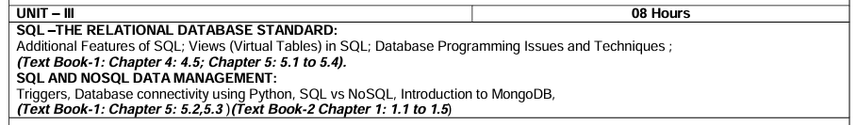
Unit 3 Relational Database Model

Slide 3
Additional Features of SQL
Views: Virtual tables derived from SELECT queries for simplified data access and security control.
Indexes: Data structures improving query performance by quick access to rows based on column values.
Transactions: Sequences of operations ensuring data consistency and integrity.
Stored Procedures and Functions: Reusable blocks of SQL code enhancing modularity and performance.
Triggers: Automated procedures executing on specific events like INSERT, UPDATE, or DELETE.
Concurrency Control: Managing concurrent data access to ensure consistency and isolation.
Recursive Queries: Handling recursion for tasks like hierarchical data traversal.
Analytic Functions: Powerful functions for advanced data analysis, e.g., ranking, windowing.
Data Types and Constraints: Defining data structure and integrity through various types and constraints.
Dynamic SQL: Generating and executing SQL statements dynamically at runtime.

Slide 4
Additional Features of SQL
SQL features: various techniques for specifying complex retrieval queries, including nested queries, aggregate functions, grouping, joined tables, outer joins, case statements, and recursive queries
In addition to the SQL commands, a set of commands for specifying physical database design parameters, file structures for relations, and access paths such as indexes.
SQL has language constructs for specifying the granting and revoking of privileges to users.
SQL has incorporated many features from object-oriented models to have more powerful capabilities, leading to enhanced relational systems known as object-relational.
SQL and relational databases can interact with technologies such as XML

Slide 5
Views (Virtual Tables) in SQL
Concept of a View in SQL
A view in SQL terminology is a single table that is derived from other tables
A view does not necessarily exist in physical form it is considered to be a virtual table
This limits the possible update operations that can be applied to views, but it does not provide any limitations on querying a view

Slide 6
Definition,Characterisitcs of Views
Definition:
Virtual tables derived from SELECT queries.
Present a customized view of the data stored in one or more tables.
Characteristics:
Abstraction: Hides complexity by presenting specific data subsets.
Security: Control access by limiting visibility of certain columns or rows.
Simplicity: Simplifies complex queries by encapsulating logic.

Slide 7
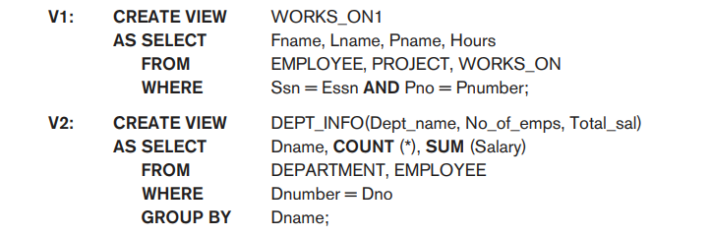
Specification of views
The command to specify a view is CREATE VIEW
The view is given a virtual table name or view name, a list of attribute names, and a query to specify the contents of the view
The views in V1 and V2 create virtual tables whose schemas are illustrated in example query

Slide 8
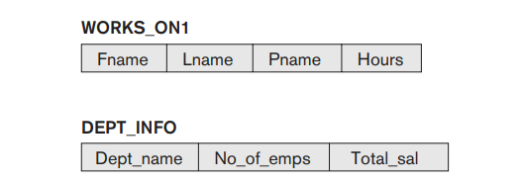
Specification of views
Two views specified on the database schema

Slide 9
Specification of views
In V1, not specified any new attribute names for the view WORKS_ON1
WORKS_ON1 inherits the names of the view attributes from the defining tables EMPLOYEE, PROJECT, and WORKS_ON.
V2 explicitly specifies new attribute names for the view DEPT_INFO
Using a one-to-one correspondence between the attributes specified in the CREATE VIEW clause
Those specified in the SELECT clause of the query that defines the view.

Slide 10
Specification of views
We can now specify SQL queries on a view—or virtual table—in the same way we specify queries involving base tables.
For example, to retrieve the last name and first name of all employees who work on the ‘ProductX’ project, we can utilize the WORKS_ON1 view and specify the query as in QV1:
QV1: SELECT Fname, Lname
FROM WORKS_ON1
WHERE Pname = ‘ProductX’;

Slide 11
View Implementation
The problem of how a DBMS can efficiently implement a view for efficient querying is complex.
Two main approaches have been suggested.
Query modification
View Materialization

Slide 12
View Implementation
Query modification, involves modifying or transforming the view query into a query on the underlying base tables.
For example, the query QV1 would be automatically modified to the following query by the DBMS
Select Fname, Lname From Employee, Project, Works_On
Where SSN=ESSN, Pno=Pnumber And Pname=‘ProductX’
The disadvantage of this approach is that it is inefficient for views defined via complex queries that are time-consuming to execute, especially if multiple view queries are going to be applied to the same view within a short period of time.

Slide 13
View Implementation
The second strategy, called view materialization
View materialization refers to the process of storing the result set of a view as a physical table in the database.
Materialized views contain precomputed results, which are updated periodically or on-demand to reflect changes in underlying data.
Automatically updating the view table when the base tables are updated must be developed in order to keep the view up-to-date
Techniques using the concept of incremental update
The view is generally kept as a materialized (physically stored) table as long as it is being queried.

Slide 14
Update on Views
You can update that view which depends on only one table. SQL will not allow updating the view which is created more than one table.
The views cannot be updatable if the SELECT statement used to create a View contains JOIN or HAVING or GROUP BY clause.
If any field of view contains any SQL aggregate function, you cannot modify the view.

Slide 15

Example to Update a View
If update the Student_View and add the Stu_Name attribute from the Student table in the view, you have to type the following Replace query in SQL:
CREATE OR REPLACE VIEW Student_View AS
SELECT Student_ID, Stu_Name, Stu_Subject, Stu_Marks
FROM Student_Details
WHERE Stu_Subject = 'Math';

Slide 16
Insertion of New Record in Views
We can also insert the record in the views. The following SQL INSERT statement is used to insert the new row or record in the view
To insert the record of a new student in the Student_View, then you have to write the following query in SQL:
INSERT INTO Student_View (Student_ID, Stu_Subject, Stu_Marks) VALUES (1007, Hindi, 89);

Slide 17
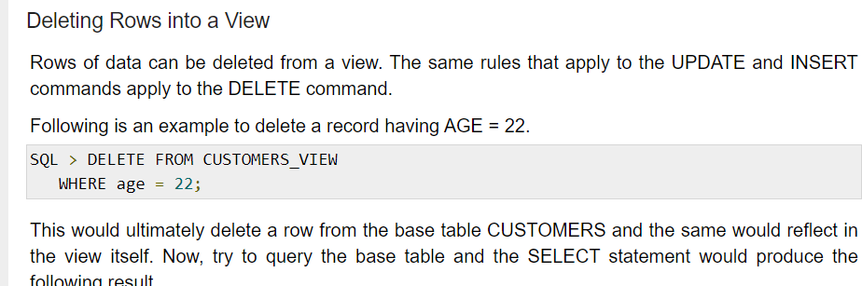
Deleting Record in view

Slide 18
Drop a view
We can also delete the existing view from the database if it is no longer needed.
The following SQL DROP statement is used to delete the view:
DROP VIEW View_Name;

Slide 19
Inline Views
An inline view is a view which is created by replacing a subquery in the from clause which defines the data source that can be referenced in the main query.
The sub query must be given an alias for efficient working.
Inline views can help make complex queries simpler by removing compound calculations or eliminating join operations
While condensing several separate queries into a single simplified query.

Slide 20
Example: Inline View
The SQL statement marked in SAL_AVG represents the inline view code.
The query returns each employee matched to their salary and department id.
In addition, the query returns the average salary for each department using the inline view column SAL_AVG.
Query
SELECT A.LAST_NAME, A.SALARY, A.DEPARTMENT_ID, B.SAL_AVG FROM EMPLOYEES A, (SELECT DEPARTMENT_ID, ROUND(AVG(SALARY)) AS SAL_AVG FROM EMPLOYEES GROUP BY DEPARTMENT_ID)
WHERE A.DEPARTMENT_ID = B.DEPARTMENT_ID;

Slide 21
View As Authorization Mechanisms
Simple examples to illustrate how views can be used to hide certain attributes or tuples from unauthorized users.
Suppose a certain user is only allowed to see employee information for employees who work for department 5
Create DEPT5EMP and grant the user the privilege to query the view but not the base table EMPLOYEE itself

Slide 22
View As Authorization Mechanisms
This user will only be able to retrieve employee information for employee tuples whose Dno = 5, and will not be able to see other employee tuples when the view is queried.
CREATE VIEW DEPT5EMP
AS
SELECT * FROM EMPLOYEE
WHERE Dno = 5;

Slide 23
View As Authorization Mechanisms
In a similar manner, a view can restrict a user to only see certain columns;
For example, only the first name, last name, and address of an employee may be visible as follows
CREATE VIEW BASIC_EMP_DATA
AS
SELECT Fname, Lname, Address FROM EMPLOYEE;

Slide 24
Trigger
Triggers:
Triggers are special types of stored programs in MySQL that are automatically executed (fired) in response to certain events on a particular table.
Triggers can be useful for enforcing business rules, maintaining data integrity, auditing changes, and other automated tasks.

Slide 25
Trigger
Types:
BEFORE triggers: These triggers are executed before an insert, update, or delete operation on a table.
AFTER triggers: These triggers are executed after an insert, update, or delete operation on a table.
Both types of triggers can be defined for the following events:
INSERT
UPDATE
DELETE

Slide 26
Trigger
CREATE TRIGGER trigger_name
BEFORE INSERT ON table_name
FOR EACH ROW
BEGIN
-- Trigger logic goes here
-- For example, setting a default value for a column
IF NEW.column_name IS NULL THEN
SET NEW.column_name = 'Default Value';
END IF;
END;
CREATE TRIGGER before_insert_student1
BEFORE INSERT ON student1
FOR EACH ROW
BEGIN
IF NEW.section IS NULL THEN
SET NEW.section = 'A';
END IF;
END;

Slide 27
Trigger
CREATE TRIGGER before_insert_student1
BEFORE INSERT ON student1
FOR EACH ROW
BEGIN
IF NEW.section IS NULL THEN
SET NEW.section = 'A';
END IF;
END;
DELIMITER //
CREATE TRIGGER before_insert_student1
BEFORE INSERT ON student1
FOR EACH ROW
BEGIN
IF NEW.section IS NULL THEN
SET NEW.section = 'A';
END IF;
END//
DELIMITER ;

Slide 28
Trigger
CREATE TABLE student1_audit (
audit_id INT AUTO_INCREMENT PRIMARY KEY,
student_id INT,
old_mark INT,
new_mark INT,
update_time DATETIME DEFAULT CURRENT_TIMESTAMP
);
CREATE TRIGGER after_update_student1
AFTER UPDATE ON student1
FOR EACH ROW
BEGIN
IF OLD.mark <> NEW.mark THEN
INSERT INTO student1_audit (student_id, old_mark, new_mark)
VALUES (OLD.id, OLD.mark, NEW.mark);
END IF;
END;

Slide 29
Trigger
CREATE TRIGGER before_delete_student1
BEFORE DELETE ON student1
FOR EACH ROW
BEGIN
IF OLD.mark > 80 THEN
SIGNAL SQLSTATE '45000'
SET MESSAGE_TEXT = 'Cannot delete students with mark above 80’;
END IF;
END//

Slide 30
Trigger
Viewing Triggers:
SHOW TRIGGERS;
Dropping Triggers:
DROP TRIGGER IF EXISTS trigger_name;
DROP TRIGGER trigger_name;

Slide 31
Trigger
The event(s) that triggers the rule: These events are usually database update operations that are explicitly applied to the database. However, in the general model, they could also be temporal events or other kinds of external events
The condition that determines whether the rule action should be executed: Once the triggering event has occurred, an optional condition may be evaluated.
The action to be taken: The action is usually a sequence of SQL statements, but it could also be a database transaction or an external program that will be automatically executed.

Slide 32
Database Programming: Techniques and Issues
Most database systems have an interactive interface where these SQL commands can be typed directly into a monitor for execution by the database system.
• Execute file of commands
– @ <file name>
• Application programs or database applications
– Used as canned transactions by the end users access a database
– May have Web interface

Slide 33
Database Programming Issues
Performance Problems: Slow query execution, high CPU usage, and long response times can all contribute to performance issues in a database system. This can be caused by inefficient queries, improper indexing, inadequate hardware resources, or suboptimal database design.
Concurrency Issues: When multiple users or applications attempt to access and modify the same data simultaneously, it can lead to concurrency issues such as deadlocks, race conditions, and inconsistent data states. Implementing proper transaction management and isolation levels can help mitigate these problems.

Slide 34
Database Programming Issues(Contd)
Data Integrity Violations: Data integrity issues occur when the data stored in the database does not meet the specified constraints or business rules. This can include violations of referential integrity (e.g., orphaned records), uniqueness constraints, and domain constraints. Regular data validation and integrity checks are essential to maintain data consistency.
Security Vulnerabilities: Databases are often targeted by malicious actors seeking to access sensitive information or execute unauthorized operations. Common security vulnerabilities include SQL injection, privilege escalation, inadequate authentication and authorization mechanisms, and weak encryption practices. Implementing robust security measures such as parameterized queries, access controls, encryption, and regular security audits can help mitigate these risks.

Slide 35
Database Programming Issues(Contd)
Data Backup and Recovery: Failure to regularly backup database data and implement proper disaster recovery procedures can result in data loss and downtime in the event of hardware failures, software bugs, or malicious attacks. It's essential to establish a reliable backup strategy, including offsite backups and automated backup scheduling, to ensure data availability and integrity.
Scalability Challenges: As the volume of data and the number of users accessing the database grow, scalability becomes a concern. Scaling databases to handle increased workload while maintaining performance requires careful planning and implementation of strategies such as sharding, replication, and vertical or horizontal scaling.

Slide 36
Database Programming Issues( contd.)
Compatibility Issues: Migrating databases to new versions or platforms can sometimes lead to compatibility issues, where certain features or functionalities behave differently or become deprecated. It's essential to thoroughly test database upgrades and ensure compatibility with existing applications and dependencies.
Resource Management: Inadequate resource management, such as insufficient memory, disk space, or CPU resources, can impact database performance and availability. Monitoring resource usage and optimizing database configuration settings can help address these issues.

Slide 37
Database Programming Techniques
SQL (Structured Query Language):
SQL is the standard language for relational database management systems (RDBMS).
It is used to perform various operations such as querying data, updating records, creating and modifying database schema, and managing user permissions.
SQL queries can be categorized into Data Definition Language (DDL), Data Manipulation Language (DML), Data Control Language (DCL), and Transaction Control Language (TCL) statements.
Stored Procedures:
Stored procedures are precompiled SQL code that is stored in the database and can be executed by calling its name.
They can encapsulate complex business logic, improve performance by reducing network traffic, and enhance security by controlling access to database objects.

Slide 38
Database Programming Techniques
Triggers:
Triggers are database objects that are automatically executed in response to specific data manipulation events (e.g., INSERT, UPDATE, DELETE) on a table.
They can be used to enforce data integrity constraints, audit changes to data, and perform automated actions based on certain conditions.
Triggers can be defined to execute either before or after the triggering event occurs.
Notes:
Title+Director, Title+Genre, Title +year+director

Slide 39
Database Programming Techniques
ORM (Object-Relational Mapping):
ORM is a programming technique that maps object-oriented domain models to relational database tables.
It abstracts away the complexities of SQL and allows developers to work with objects directly, improving code readability and maintainability.
Popular ORM frameworks include Hibernate (Java), Entity Framework (C#), SQLAlchemy (Python), and Sequelize (Node.js).

Slide 40
Database Programming Techniques
Connection Pooling:
Connection pooling is a technique used to manage a pool of database connections that can be reused by multiple clients.
It helps improve application performance by reducing the overhead of establishing new database connections for each request.
Connection pooling libraries and frameworks are available for most programming languages and database systems.

Slide 41
Database Programming Techniques
Indexing:
Indexing is the process of creating data structures (indexes) on one or more columns of a database table to improve query performance.
Indexes allow the database engine to quickly locate and retrieve data based on the indexed columns, reducing the need for full table scans.
Common types of indexes include single-column indexes, composite indexes, unique indexes, and full-text indexes.
Transactions:
Transactions are units of work that are performed on a database and must either be completed entirely or rolled back if an error occurs.
They ensure data consistency and integrity by enforcing the ACID properties (Atomicity, Consistency, Isolation, Durability).

Slide 42
Approaches to Database Programming
Embedding database commands in a general-purpose programming language. In this approach, database statements are embedded into the host programming language, but they are identified by a special prefix.
Using a library of database functions or classes. A library of functions is made available to the host programming language for database calls.
Designing a brand-new language. A database programming language is designed from scratch to be compatible with the database model and query language.

Slide 43
Impedance Mismatch
Impedance mismatch is the term used to refer to the problems that occur because of differences between the database model and the programming language model.
The first problem that may occur is that the data types of the programming language differ from the attribute data types that are available in the data model.
To have a binding for each host programming language that specifies for each attribute type the compatible programming language types
Impedance mismatch is less of a problem when a special database programming language is designed that uses the same data model and data types as the database model.

Slide 44
Typical Sequence of Interaction in Database Programming
When the application program requires access to a particular database, the program must first establish or open a connection to the database server.
Once the connection is established, the program can interact with the database by submitting queries, updates, and other database commands.
When the program no longer needs access to a particular database, it should terminate or close the connection to the database

Slide 45
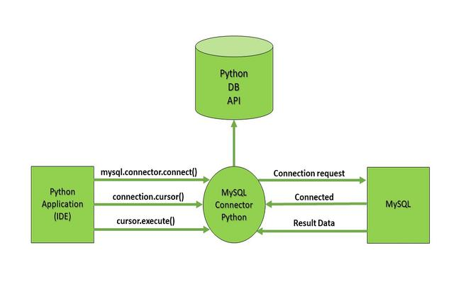
Database connectivity Using Python
Python is a high-level, general-purpose, and very popular programming language.
Connect SQL with Python using the ‘MySQL Connector Python module

Slide 46
Connecting MySQL with Python
To create a connection between the MySQL database and Python, the connect() method of mysql.connector module is used. We pass the database details like HostName, username, and the password in the method call, and then the method returns the connection object.

Slide 47
The following steps are required to connect SQL with Python:
Step 1: Download and Install the free MySQL database
Step 2: After installing the MySQL database, open your Command prompt.
Step 3: Navigate your Command prompt to the location of PIP.
Step 4: Now run the commands given below to download and install “MySQL Connector”.
Download and install “MySQL Connector”
pip install mysql-connector-python
Step 5: Test MySQL Connector
To check if the installation was successful, or if you already installed “MySQL Connector”, go to your IDE and run the given below code : import mysql.connector

Slide 48
Contd
Step 6: Create Connection
Now to connect SQL with Python, run the code given below in your IDE.
import mysql.connector
mydb = mysql.connector.connect(
host = "localhost",
user = "yourusername",
password = "your_password")
print(mydb)

Slide 49
Create MySql Database
import mysql.connector
mydb = mysql.connector.connect(
host = "localhost",
user = "yourusername",
password = "your_password"
)
cursor = mydb.cursor()
cursor.execute("CREATE DATABASE DB")

Slide 50
SQL VS NOSQL
SQL databases are primarily called Relational Databases (RDBMS); whereas NoSQL databases are primarily called non-relational or distributed databases.
SQL databases define and manipulate data-based structured query language (SQL). Seeing from a side this language is extremely powerful.
SQL requires you to use predefined schemas to determine the structure of your data before you work with it.

Slide 51
NoSQL
A NoSQL database has a dynamic schema for unstructured data. Data is stored in many ways which means it can be document-oriented, column-oriented, graph-based, or organized as a key-value store.
This flexibility means that documents can be created without having a defined structure first.

Slide 52
Scalability
In almost all situations SQL databases are vertically scalable. This means that you can increase the load on a single server by increasing things like RAM, CPU, or SSD.
But on the other hand, NoSQL databases are horizontally scalable.
This means that you handle more traffic by sharing, or adding more servers in your NoSQL database.
NoSQL can ultimately become larger and more powerful, making these databases the preferred choice for large or ever-changing data sets.

Slide 53
Structure
SQL databases are table-based on the other hand NoSQL databases are either key-value pairs, document-based, graph databases, or wide-column stores.
Here is a simple example of how a structured data with rows and columns vs a non-structured data without definition might look like.
A product table in SQL db might accept data looking like this:
{ “id”:“101”, “category”:”food” “name”:”Apples”, “qty”:”150″ }

Slide 54
Contd
Whereas a unstructured NOSQL DB might save the products in many variations without constraints to change the underlying table structure
Products=[ { “id”:”101: “category”:”food”,, “name”:”California Apples”, “qty”:”150″ },
{ “id”:”102, “category”:”electronics” “name”:”Apple MacBook Air”, “qty”:”10″, “specifications”: { “storage”:”256GB SSD”, “cpu”:”8 Core”, “camera”: “1080p FaceTime HD camera” } } ]

Slide 55
Properties Followed
SQL databases follow ACID properties (Atomicity, Consistency, Isolation, and Durability)
NoSQL database follows the Brewers CAP theorem (Consistency, Availability, and Partition tolerance).

Slide 56
When To Use: SQL vs NoSQL
SQL is a good choice when working with related data. Relational databases are efficient, flexible, and easily accessed by any application.
NoSQL is good when the availability of big data is more crucial, SQL is valued for ensuring data validity.
NoSQL is also a wise choice when dealing with large or constantly changing data sets, flexible data models, or requirements that don’t fit into a relational model.

Slide 57
Difference between SQL vs NOSQL
SQL | NoSQL
Relational Database Management System (RDBMS) | Non-relational or distributed database system.
These databases have fixed or static or predefined schema | They have a dynamic schema
These databases are not suited for hierarchical data storage. | These databases are best suited for hierarchical data storage.
These databases are best suited for complex queries | These databases are not so good for complex queries
Vertically Scalable | Horizontally scalable
Follows ACID property | Follows CAP(consistency, availability, partition tolerance)

Slide 58
Introduction to MongoDB
MongoDB is a cross-platform, document oriented database that provides, high performance, high availability, and easy scalability. MongoDB works on concept of collection and document.
Database
Database is a physical container for collections. Each database gets its own set of files on the file system. A single MongoDB server typically has multiple databases.

Slide 59
Collection
Collection is a group of MongoDB documents.
A collection exists within a single database.
Collections do not enforce a schema.
Documents within a collection can have different fields.
Typically, all documents in a collection are of similar or related purpose.

Slide 60
Documents
A document is a set of key-value pairs. Documents have dynamic schema.
Dynamic schema means that documents in the same collection do not need to have the same set of fields or structure, and common fields in a collection's documents may hold different types of data.

Slide 61
Why Use MongoDB?
Document Oriented Storage: Data is stored in the form of JSON style documents – BSON.
Index on any attribute
Replication and high availability
Auto-sharding
Rich queries
Fast in-place updates
Professional support by MongoDB

Slide 62
Where to Use MongoDB?
Big Data
Content Management and Delivery
Mobile and Social Infrastructure
User Data Management
Data Hub

Slide 63
Install MongoDB on Windows
To install MongoDB on Windows, first download the latest release of MongoDB from http://www.mongodb.org/downloads.

Slide 64
Some considerations while designing Schema in MongoDB
Design your schema according to user requirements.
Combine objects into one document if you will use them together. Otherwise separate them (but make sure there should not be need of joins).
Duplicate the data (but limited) because disk space is cheap as compare to compute time.
Do joins while write, not on read.
Optimize your schema for most frequent use cases.
Do complex aggregation in the schema.

Slide 65
Example
Suppose a client needs a database design for website and see the differences between RDBMS and MongoDB schema design, Website has the following requirements.
Every post has the unique title, description and url.
Every post can have one or more tags.
Every post has the name of its publisher and total number of likes.
Every post has comments given by users along with their name, message, data-time and likes.
On each post, there can be zero or more comments.

Slide 66
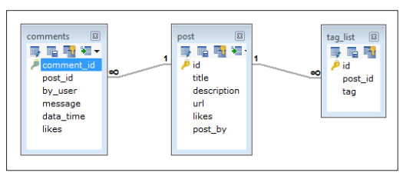
In RDBMS schema, design for above requirements will have minimum three tables.

Slide 67
While in MongoDB schema, design will have one collection post and the following structure:
{
_id: POST_ID
title: TITLE_OF_POST,
description: POST_DESCRIPTION,
by: POST_BY,
url: URL_OF_POST,
tags: [TAG1, TAG2, TAG3],
likes: TOTAL_LIKES,
comments: [ { user:'COMMENT_BY’, message: TEXT, dateCreated: DATE_TIME, like: LIKES }]
}

Slide 68
MongoDB Create Database
The use Command
MongoDB use DATABASE_NAME is used to create database. The command will create a new database if it doesn't exist, otherwise it will return the existing database.
Syntax
Basic syntax of use DATABASE statement is as follows:
use DATABASE_NAME

Slide 69
Contd
Example
If you want to create a database with name <mydb>, then use DATABASE statement would be as follows:
>use mydb
switched to db mydb

Slide 70
To check your currently selected database, use the command db
>db
Mydb
If you want to check your databases list, use the command show dbs.

Slide 71
MongoDB – Drop Database
The dropDatabase() Method
MongoDB db.dropDatabase() command is used to drop a existing database.
Syntax
db.dropDatabase()

Slide 72
MongoDB Create Collection
The createCollection() Method
MongoDB db.createCollection(name, options) is used to create collection.
Syntax
db.createCollection(name, options)
In the command, name is name of collection to be created. Options is a document and is used to specify configuration of collection.

Slide 73
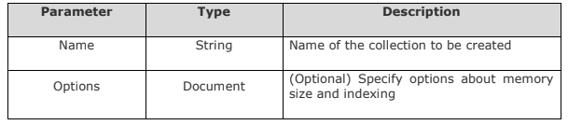

Slide 74
Examples
Basic syntax of createCollection() method without options is as follows:
>use test
switched to db test
>db.createCollection("mycollection")
{ "ok" : 1 }
>

Slide 75
The following example shows the syntax of createCollection() method with few important options:
>db.createCollection("mycol", { capped : true, autoIndexID : true, size : 6142800, max : 10000 } )
{ "ok" : 1 }
>

Slide 76
In MongoDB, you don't need to create collection. MongoDB creates collection automatically, when you insert some document.
>db.tutor.insert({"name" : "tutor"})
>show collections
mycol
mycollection
system.indexes
tutor
>

Slide 77
Thank You

